Slide 1
How to use MrBayes
Wen-Bin Yu
jModelTest
Best-fit model selection
MrBayes

Slide 2
Step 1: Installing jModelTest
Local machine installation
Program website: https://drive.google.com/drive/u/0/folders/0ByrkKOPtF_n_OUs3d0dNcnJPYXM
Decompress the file, and add directory to $PATH
Can be command line or Graphic User Interface
CIPRES Science Gateway
https://www.phylo.org/

Slide 3
Step 2: Model selection
Graphical User Interface
java -jar ~/src/jmodeltest-2.1.10/jModelTest.jar
Command line
java -jar ~/src/jmodeltest-2.1.10/jModelTest.jar -d ~/Desktop/MrBayes_Test/primates.phy -g 4 -i -f -AIC -BIC -a -o ~/Desktop/MrBayes_Test/primates_jmodeltest
CIPRES Science Gateway
https://www.phylo.org/

Slide 4
Step 3: Create cmd block file
[BIC model]
begin mrbayes;
log start filename=BI-BIC.out replace;
[CHARSET A_gene= 1-625;
CHARSET B_gene = 626-1330;
CHARSET C_gene = 1331-1954;
CHARSET D_gene = 1955-2613;
CHARSET E_gene = 2614-3658;
partition favored=5: A_gene, B_gene, C_gene, E_gene, F_gene;
set partition = favored;
unlink revmat=(all) tratio=(all) statefreq=(all) shape=(all);]
lset [applyto=(1)] nst=6 rates=gamma;
prset [applyto=(1)] statefreqpr=fixed(0.3637, 0.3199, 0.0815, 0.2349) tratio=fixed(5.3962) shapepr=fixed(0.3630) pinvar=fixed(0.0000); [A_gene Model = HKY+G]
[lset applyto=(2) nst=6 rates=gamma; prset applyto=(2) statefreqpr=fixed(0.3605,0.1787,0.1694,0.2914) revmat=fixed(1.0000,3.1477,0.3889,0.3889,3.1477,1.0000) shapepr=fixed(0.4080) pinvar=fixed(0.0000);[B_gene Model = TPM1uf+G] ]
[.....]
mcmc ngen=100000 relburnin=yes burninfrac=0.25 printfreq=100 samplefreq=100 nchains=4 savebrlens=yes;
sump burnin=250;
sumt burnin=250;
log stop;
end;

Slide 5
Step 4: Installing MrBayes
Local machine installation
Program website: http://mrbayes.sourceforge.net/manual.php
Decompress the file, and add directory to $PATH
However, this may not run properly by missing something.
Using miniconda
Install miniconda:
curl -O https://repo.continuum.io/miniconda/Miniconda2-latest-MacOSX-x86_64.sh
bash Miniconda2-latest-MacOSX-x86_64.sh
source ~/.bash_profile
Install MyBayes
conda install mrbayes
conda update mrbayes
source ~/.bash_profile

Slide 6
Step 4: Installing MrBayes
Just run in Cipres
https://www.phylo.org/

Slide 7
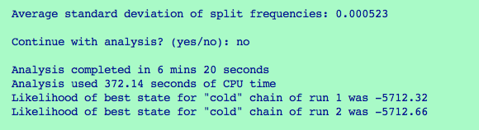
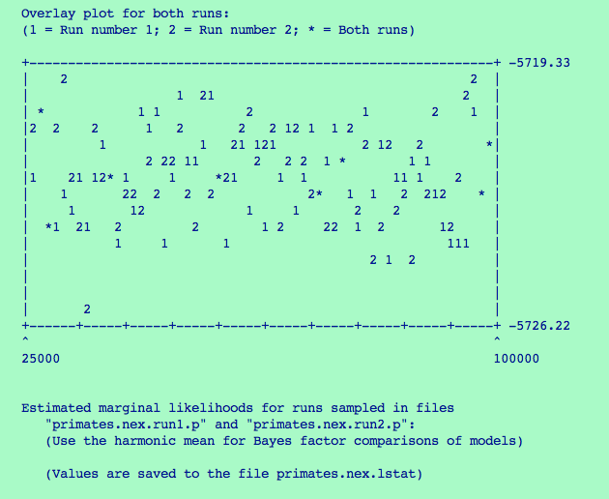
Step 5: Estimation of the runs

Slide 8
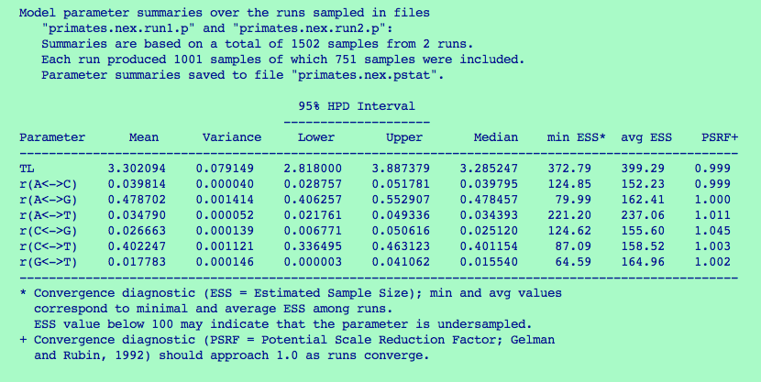
Step 5: Estimation of the runs

Slide 9
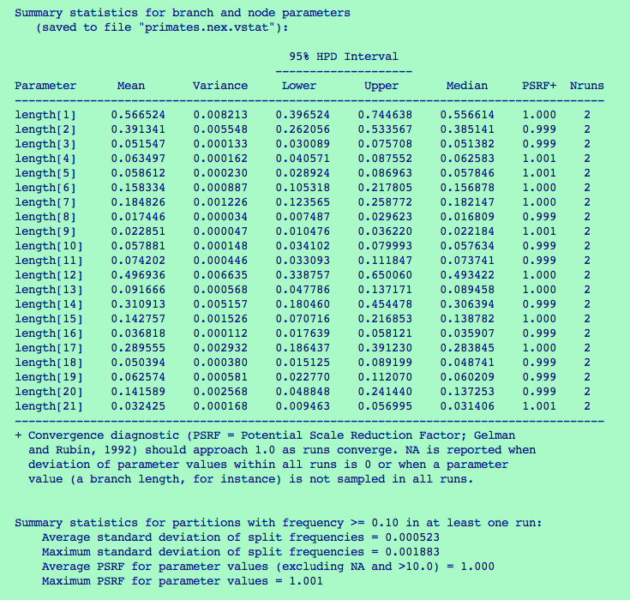
Step 5: Estimation of the runs

